Slide 1
Bayesian Monte Carlo
Carl Edward Rasmussen, Zoubin Ghahramani
Presented by:
Yassin EL HAJJ CHEHADE
Ayoub YOUSSOUFI

Slide 2
Outline
Introduction and motivation
Simple Monte Carlo
Contribution: Bayesian Monte Carlo
Optimal Importance Sampler
Experience and results
Evaluation of marginal distribution
Conclusion and discussion

Slide 3



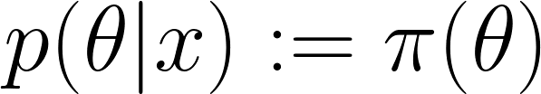
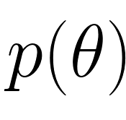

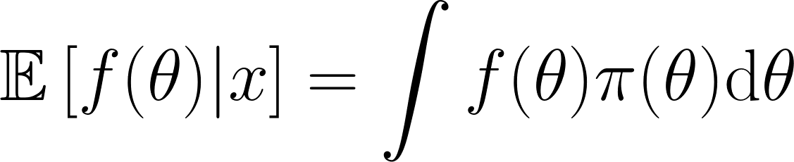
Introduction and motivation
problem: Have some data , want to infer some unknown parameter
Prior incorporation of expertise
Posterior coherent point estimation & uncertainty quantification
condition on
Main Challenge
estimate posterior expectations (sample from the posterior!)

Slide 4


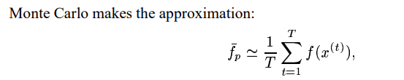

Simple Monte Carlo
If sampling from p(x) is hard we use q(x) to obtain the estimate :

Slide 5

Gaussian Process
Let’s consider the set of input
conveying information about
Under a Gaussian Process prior the joint distribution of any number of function values is Gaussian :
Where here we take the mean to be zero. Covariance matrix is given by the covariance function :

Slide 6
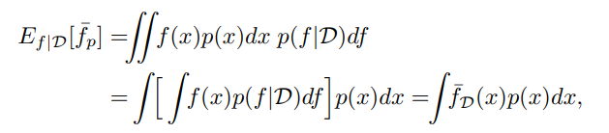
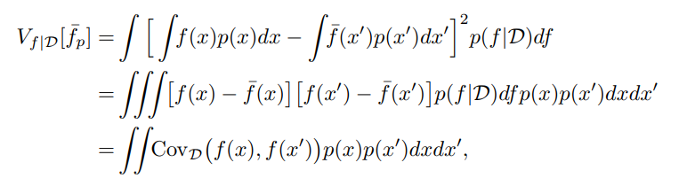
Bayesian Monte Carlo
Let’s consider the prior over the function p(f) and makes inferences about f from a set of samples D = {(x (i) , f(x (i) ))|i = 1 . . . n} giving the posterior distribution p(f|D). Under the gaussian process the prior posterior is Gaussian.
With :

Slide 7



Optimal importance Sampler
To improve efficiency of SMC, we generate independent samples from more-cleverly designed distributions. Recall the SMC formula with importance sampling q(x):
where q(x) >0, wherever p(x) >0
Then the variance of this estimator is:
In order to optimize the result (minimum variance), the optimal q(x) will be:

Slide 8
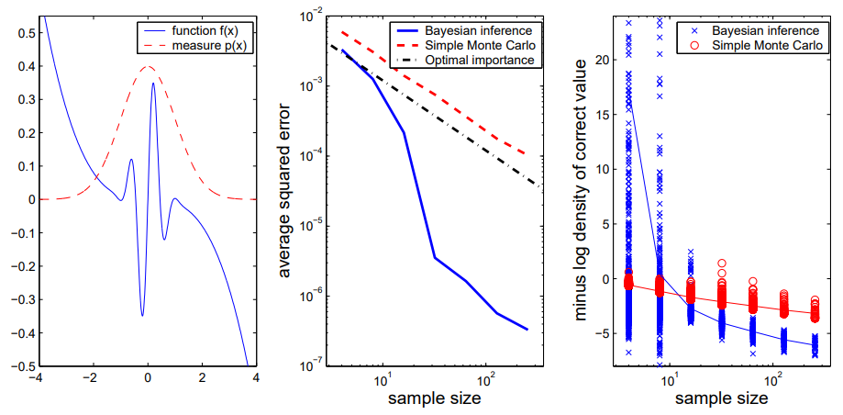
Experiences and results
Notes:
we measure f(x) using the gaussian distribution p(x). P(x) is known distribution we can choose another known dist if we want (laplace dist) → gaussian has more characteristics
→ optimal importance performs better than SMC (because improved version)

Slide 9


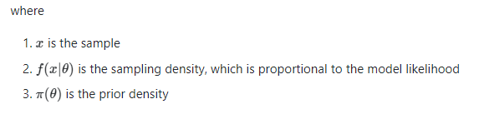
Marginal Likelihood :
Let’s consider the posterior distribution:
Where the marginal likelihood is :
Notes:
WE consider now estimating the marginal likelihood m(x). We choose the marginal because is complex problem to estimate directly using this integral.

Slide 10
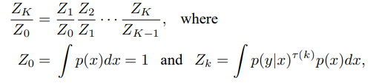
Annealed Importance Sampling (AIS)
The idea here is to divide the difficult integral into a series of easier ones, parameterised by the (inverse) temperature 𝛕.
where 𝛕(k) is drawn using a single Metropolis proposal, and 𝛕(K) = 1.
To compute each fraction we sample from the distribution :

Slide 11
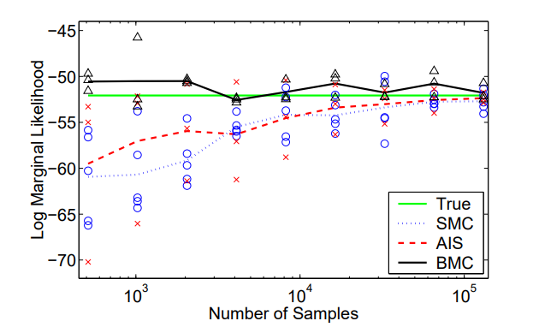
Marginal Likelihood :

Slide 12
Conclusion:
BMC performs better than SMC. However, in case of high dimensional integrands, BMC requires thousands of samples to limit the variation of the variance which is not suitable for Gaussian Process as it is limited to only few samples.
The BMC method requires that the distribution p(x) can be evaluated. This contrasts with SMC where it only requires that samples can be drawn from some distribution q(x).
Despite the limitation of the approximation of complex integral using BMC. The BMC method outperform state-of-art classical methods.

